Slide 1
O'Dwyers GAA
O’DWYERS U16 Football – Season 2016/2017
Born on or after Jan/1/2001

Slide 2
This evenings plan approx times;
7.00 I'll introduce the plan and welcome everyone.
Colm will pass a database of names and details, around the room to be corrected, updated anf collected before the end.
Ronan will speak for 2 mins about S&C.
I'll introduce our management team and they will speak for 2 mins each.
7.15 approx I'll go through these slides. Feedback on training.
7.30 handout player profiling handouts and they start immediately.
7.40 13 sets of handouts between two players(Overview now and hand back) plus a nutrition sheet each for home. Read them and player feedback to our coaches on what players would like to see more of this year.
7.50 Parents collect, sign letters and leave them back to one of our team.
7.55 refreshments and informal chats and please leave the room the way you found it.

Slide 3
Overview
Introduction.
Aims and goals
Probable Fixture breakdown to edit(when fixtures come out)
Minor, first team and club facilities
Coaching requirements
Season plan (work in progress)
Player development profiles (On handouts)
First steps screening and fitness testing.
Performance and Successful Athletes
Periodisation and Planning
Preparing to be a top athlete
S&C information including functional screening (Ian Howley)
Handout out also on Nutrition and a letter home to parents to get signed
and returned to me before our next meeting.

Slide 4
Introduction
My training sessions starting in January are in my folder, separated month by month and are a work in progress. My training sessions are built around well established principals of; quick plays (3secs on the ball), switch play(diagonal runs and plays too) , good first touch, give and go off the shoulder running in triangles, play the way your facing and take a calculated risk to play forward , break the tackle(and 6 sec of fury then defend back), Vision (head up look left and right then pick best pass option), high intensive pressing, good left and right side.
In addition, 13 years of coaching courses and reading material have added to my sessions and knowledge and I continue to build on that.
Experience something new and you’ll benefit from it.
Trips away will help you make even more friends.

Slide 5
Aim and Goals (feedback from players first)
To integrate U16 footballers into the minor set up and then the adult set up and facilitate their transition and development to adult football.
To improve the performance of individuals and the team
To help players to develop into potential Dublin players in the medium term.
To get O'Dwyers U16 into the top 3 divisions so that players are comfortable at playing at that level for adult football. Hence in the medium to long term helping our adult teams to climb leagues.
We that in mind it has been requested that we jump to division 5 rather than 6.
Management Team – Pat Lynch adult and Fintan Keenan U18
Training
TBC - U16 Tues 7-8 All weather from Tues 29th of Nov-20th Dec. No Thursdays. Back Tues Jan 10th all weather and Thursdays start on Jan 19th 2017 6.30-7.30 weather permitting. (snow or torrential storm or serious rain no training on Thur. Two week break at Christmas. Gym Thurs evening 6.30pm or Friday after school at 4.00pm?? Plus your own work.
Season Aim: To climb leagues and win a championship within the next 2-3 years.

Slide 6
U16 division 5 or 6
Management Team
Manager: John MC Garry
Assistant Manager: Dermot Coyle, Colm, Danny.
Selector : all above are selectors with the final decisions with the Manager.
Statistician, score keeper and analysis : Donal Collins/Danny Kelly
Jerseys, water and first aid: Danny Kelly
Analysis of backs/MF and forwards roles for each assistant for our team and for the
Oppositions. Dermot watching the opposition tactics.
And our mid field. Danny watching our backs.
Colm watching our forwards. I'll be watching the overall.
Coaching Team;
Supervising Coach: Ger Lyons from coaching committee or club overseeing coach
Head Coach : John Mc Garry
Assistant Coaches: Colm Smith and Danny Kelly
Strength and Conditioning Coach : Ian Howley and Experts of Platinum gyms
Captain for 201617: To be considered and alternating
Vice Captain for 201617: same

Slide 7
2016 /2017
Strength & Conditioning and Coaching
March 1st checkpoint with S&C coach
Breaking Ball, Vision plays, speed of thought, high catching, pick ups under pressure, near hand tackling and possession games.
Game fixtures
Feb: Maintain strength and conditioning. Mental training.
Drills, Skills, plyometrics
Tactical work and set plays.
End of Nov:
Testing,
Screening Workshop with S & C advisor. Fitness tests.
Jan 19th:
General cardiovascular fitness work 10km timed. Also
TRX, Speed , Power, Football training and flexibility.
20 min matches
22 Feb: 1st League Game ??
8 Mar: 2nd League Game
Dec 1: Rowing plans. Delivery of individual rehab/conditioning plans for players by S&C advisor.
Mid Feb: Challenge Game
End March: checkpoint with S&C coach
Feb: Practice training game
Dec 2016
Jan 2017
Feb 2017
Mar 2017
S & C = Strength & Conditioning

Slide 8
Player Development Areas out of 10 ratings
Player | Field Position | Upper body Strength | Speed & Agility | Aerobic Fitness | Kicking | Winning Possession | Handling | Turnovers
 | GK
 | FB
 | FB
 | FB
 | FB / HB
 | HB
 | FB / HB
 | HB / Utility
 | HB / HF
 | HB
Notes:
To adjust

Slide 9
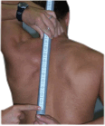
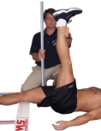
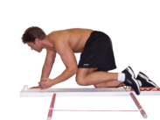
Functional Screening Test (Ian Howley)
Deep Squat
Hurdle Step
In-Line Lunge
Shoulder Mobility
Active Straight Leg Raise
Trunk Stability Push-Up
Rotational Stability

Slide 10
Next steps
1
2
3
4
5
6
Start S&C program and light football
Ongoing S&C program and main football season
Set Up
Dates
Screening
Pre-hab
Do we stay on
Agreement of 2017/18 budget
Soundings / Feedback of players for design of 2017/18
How long off a break before agreeing date for getting players screened
Players will stay off S&C Sep and Oct Screening before starting conditioning program ASAP
Selection of S&C advisor
Organising date & venue
Conduct of screening
Assessments
Test what progress players have made
Players working on their prehab plans (4 weeks)
Start of S& C program sessions or 8 weeks
Light football work – kicking based skills @ weekends .
Captain runs at the
Weekends
Combination sessions Tue & Thur – 20 Min S & C?
20 min matches

Slide 11
Components of Sporting Success
Physical Fitness
Tactical Awareness
Support System
The Individual
Lifestyle
Mental Fitness
Technical Ability

Slide 12
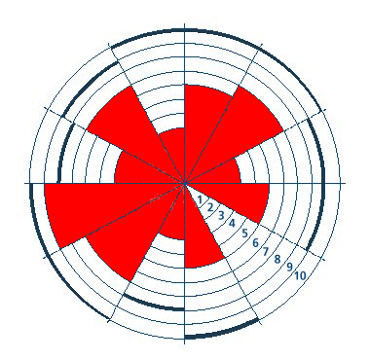
Performance Profiling
Concentration
Balance
Confidence
Speed
Aggressiveness
Strength
Rest/recovery
Power
Endurance
Agility
Nutrition

Slide 13
Phases of Periodisation
Phase | Month | Aim of this Phase
Recovery Period | Selected dates | Active Recovery
Early Preparation Period | Oct, Nov | General Strength and Endurance
Preparation Period | Dec, Jan | Max Strength & General Endurance Weights/TRX/Hard Running
Pre Competition | Feb, March | Max Strength, Speed, Flexibility & Specific Endurance
Early Competition | Apr, May | Specific Endurance, Technique
Peak Competition | June, July, Aug | Competition Preparation Conditioned games

Slide 14
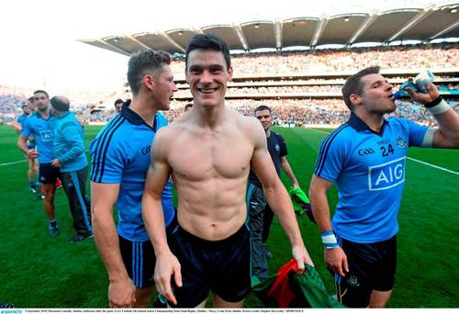
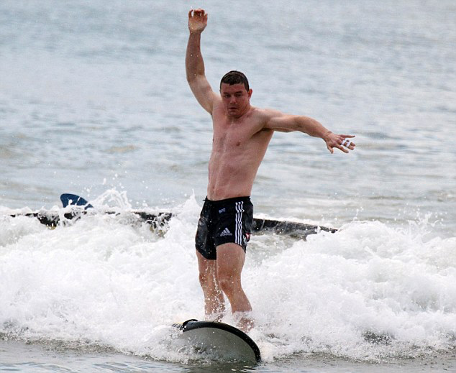
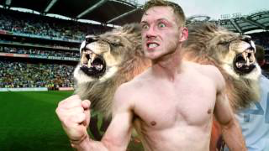
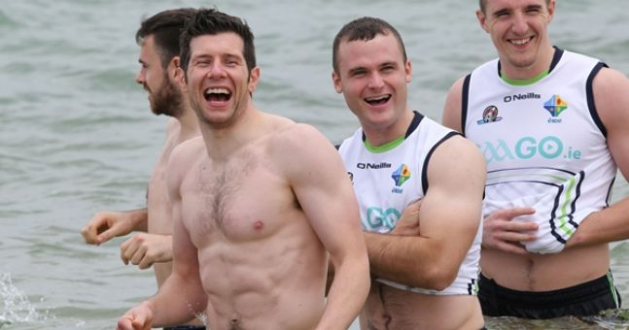
Becoming A Dublin U16 or U18 player and to play division one or two football.
Need to be disciplined, build skills outside of training too and have a good work ethic.
Need to be strong mentally as well as physically.
Enjoy what you do, have fun, have a good positive team around you.
Develop a natural rhythm and know what this feels like – neuromuscular training (muscle memory). Mental training and preparation.

Slide 15
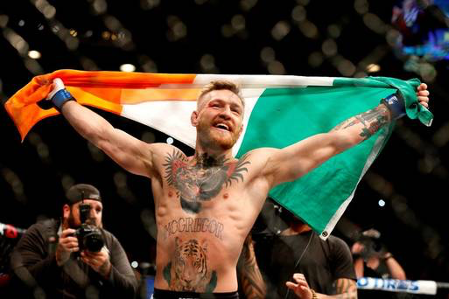
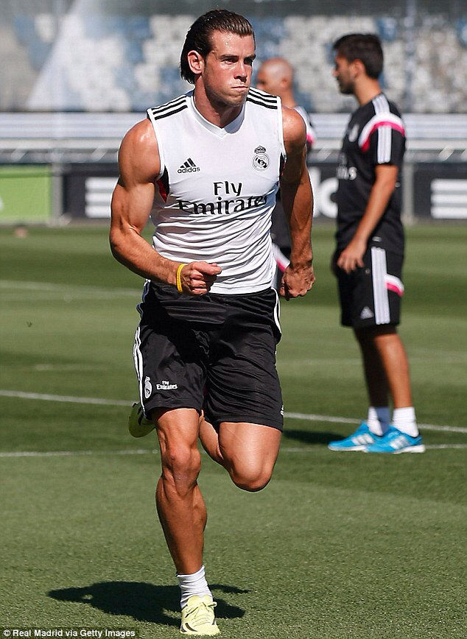
Becoming a champion built with power and speed.
Know where your fitness or technical skill needs help.
Train both sides of the body – develop weaker muscles.
Set goals, go out with a plan otherwise you’ll have a nervous tentative opening match
Use mental tactics – visualisation, imagery, tunnel vision/block out strategies. Techniques to help cope under pressure.
BELIEVE IN YOURSELF !

Slide 16
Remember….
“Insanity is doing the same thing you’ve always done and expecting different results”
Roger Milliken

Slide 17
Please leave your details with O'Dwyers if you haven't done so before
For more detail log into mrmacgarry.weebly.com/more/Gaelic Football
DOB cut off. Born on or after 01/01/2001

